Slide 1
Runtime Environment
PRATEEK ADHIKAREE (NUID: 001280941)
RASESWARI DAS (NUID: 001259634)
SOUMIYA ROY (NUID: 001220681)

Slide 2
About Runtime Environment:
Runtime Environment Inc. creates a platform that will help achieve better business standards by continuous monitoring of members, maintenance, scheduling, special services, accounting, marketing, reporting and more in the international level as well.
This portal would enable the customers easy & comprehensive access to their fitness accounts, view sessions, profiles and activities. In the process, Runtime Environment Inc. can understand the sessions and their demands so that they can take their business to greater heights.

Slide 3
Object Model:

Slide 4
Roles:
Super Admin- Manages organization details (CRUD on a gyms) and can view analytics
Marketing- Views the analytics globally
Vendor- Login to receive complaints and track maintenance of the existing equipment.
Admin- Assigned to each gym (branch) and can view dashboard, trainers and members, schedule and send complaint to maintenance and vendor
Accountant- Mapped to every branch (gym) and can view the respective accounts.
Maintenance- Receive complaints and report equipment issues to vendor.
Master Trainer- View class schedule assigned to them and arrange training classes for other trainers.
Trainer- View class schedule assigned to them
Customer- can create accounts and access the whole system depending on their requirements, for example view group classes, check their membership or send query to the company before logging in. NOTE: Each user can upload profiles and send messages to one another

Slide 5
Special Features:
Marketing Analytics
Currency Conversion
Promo Code
Inbox

Slide 6
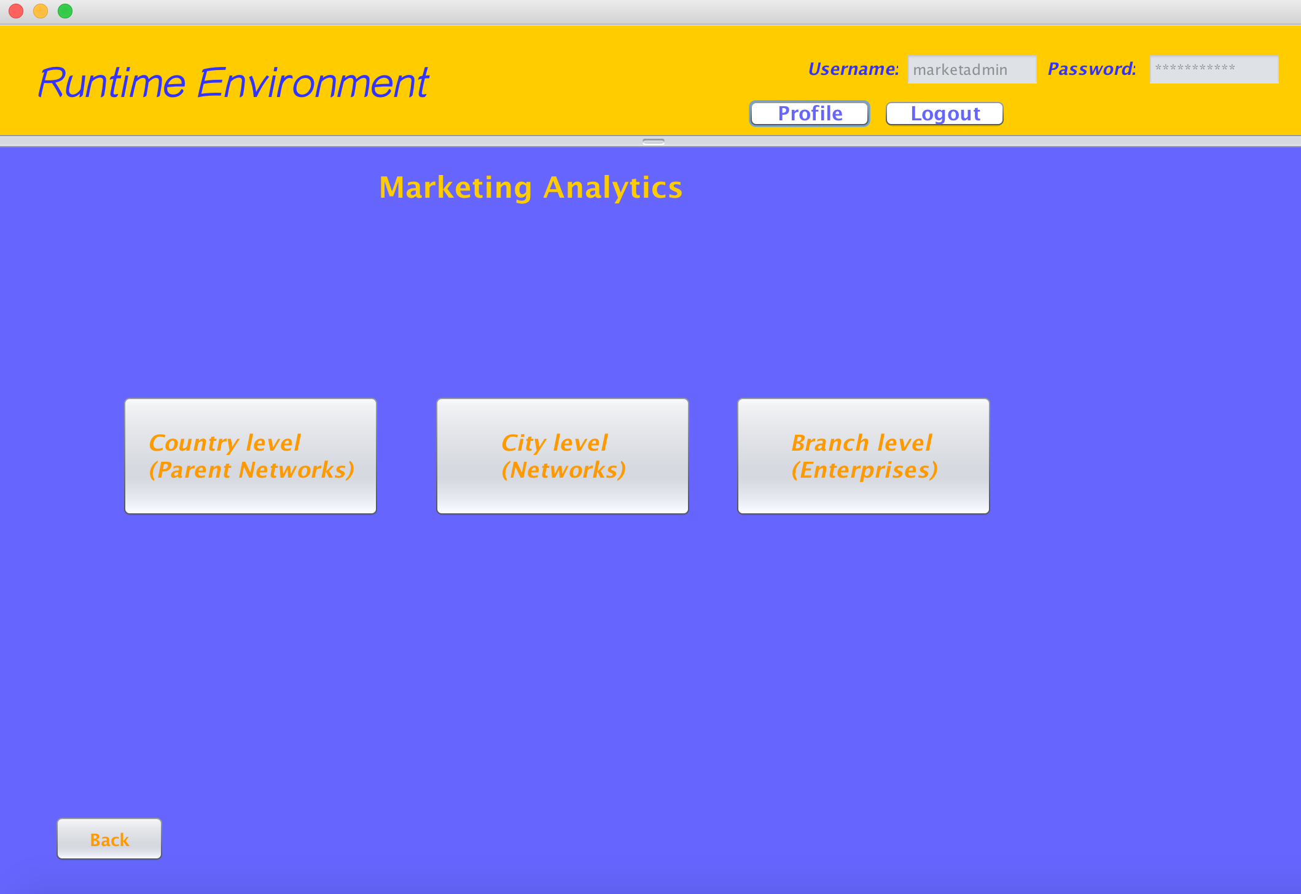
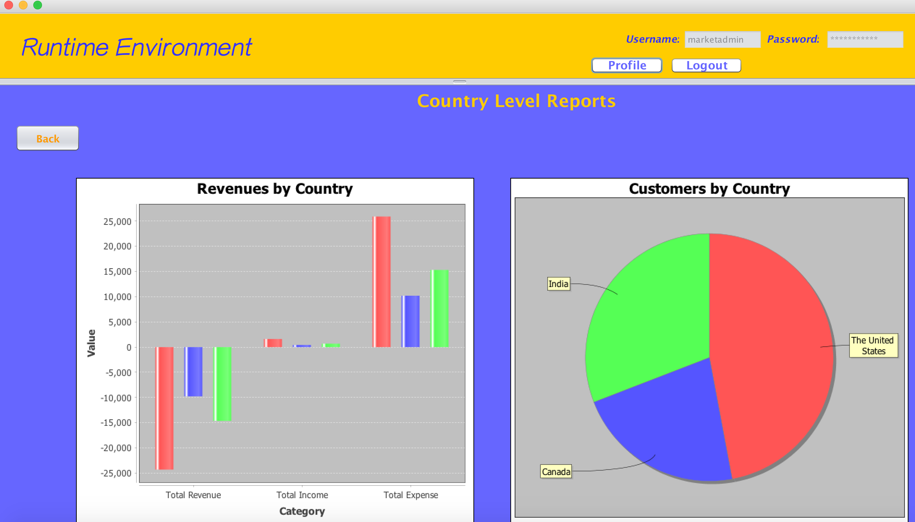
Special Features: Marketing Analytics

Slide 7
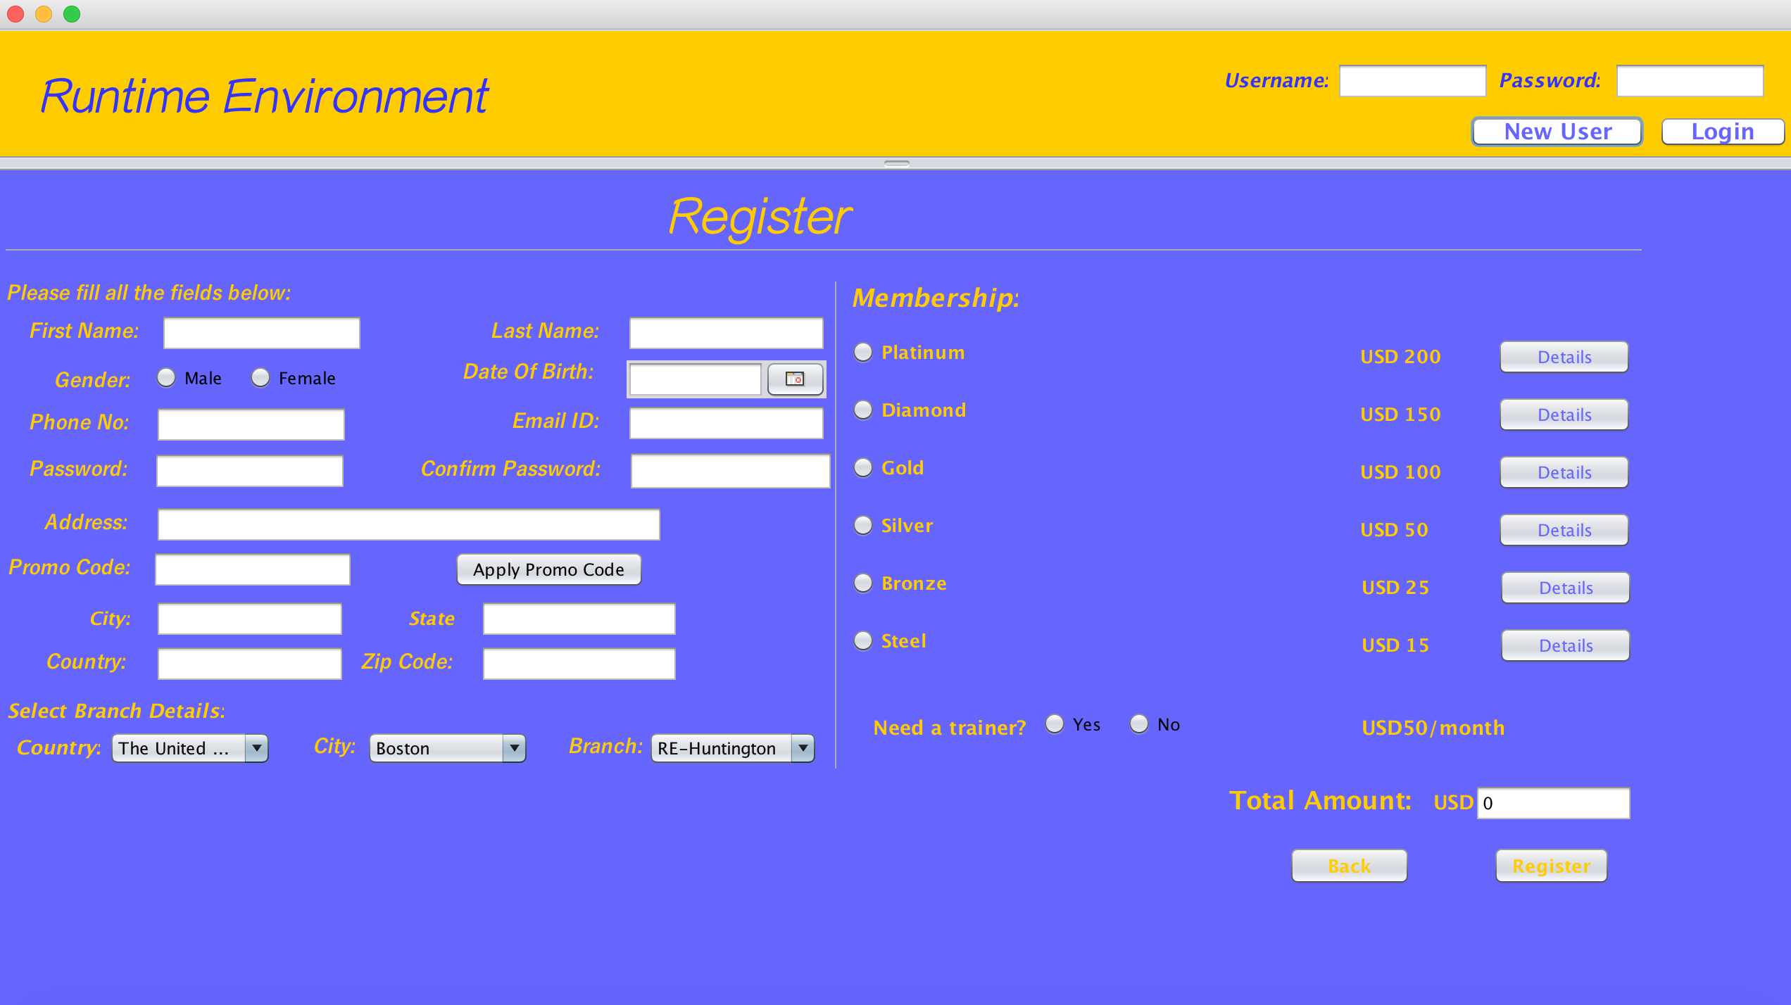

Special Features: Currency Conversion

Slide 8
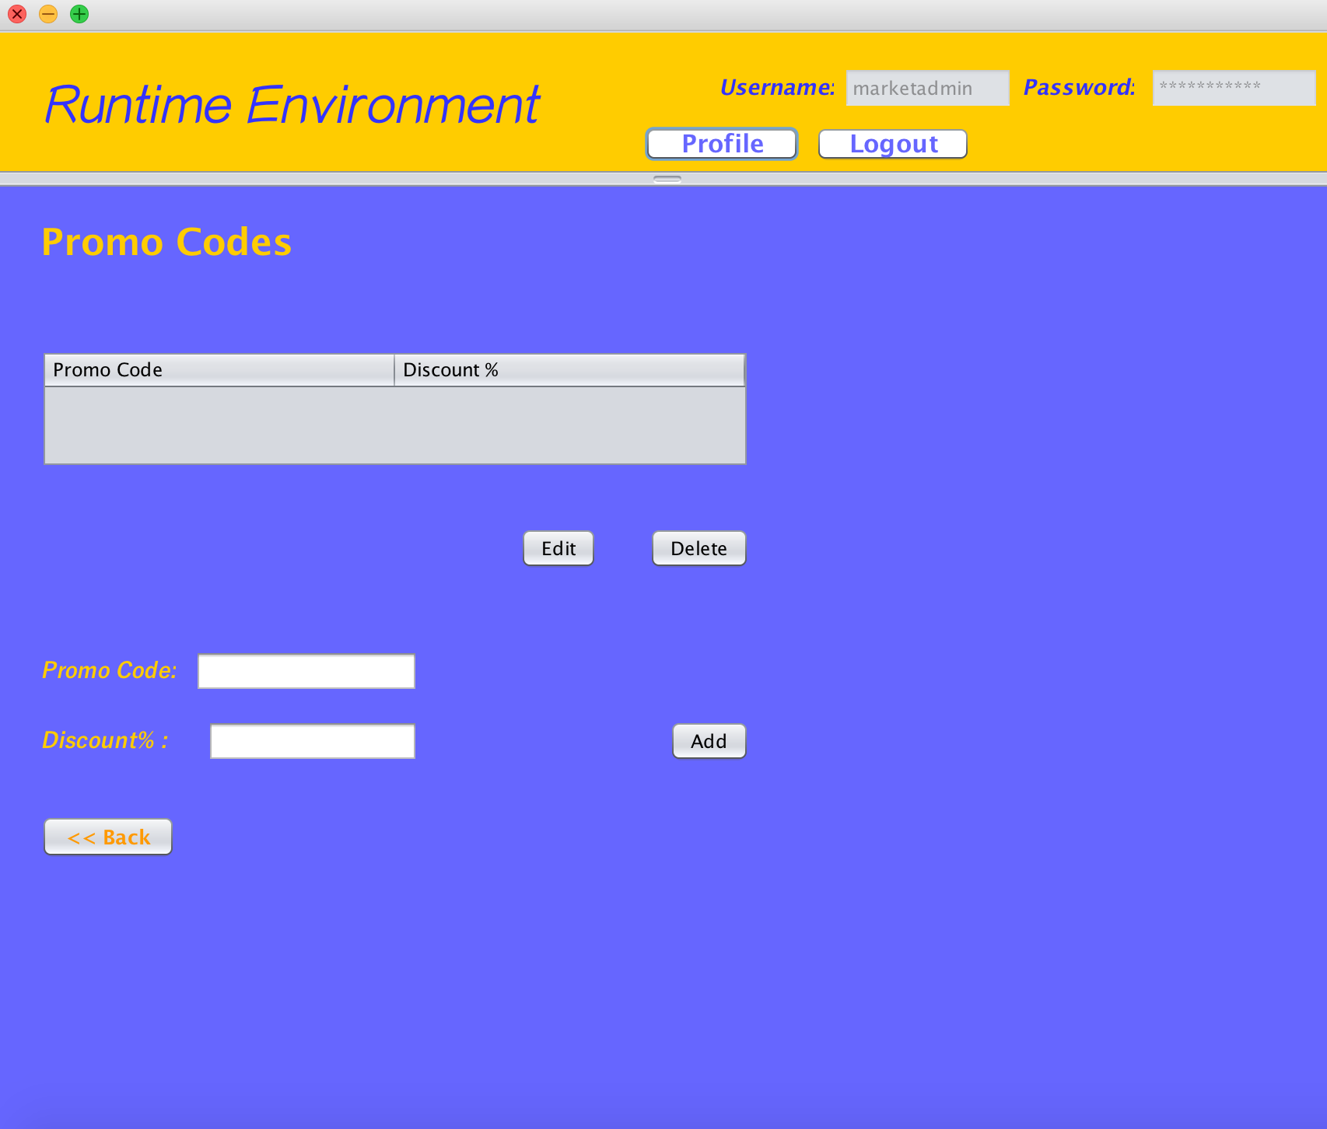
Special Features: Promo Code

Slide 9
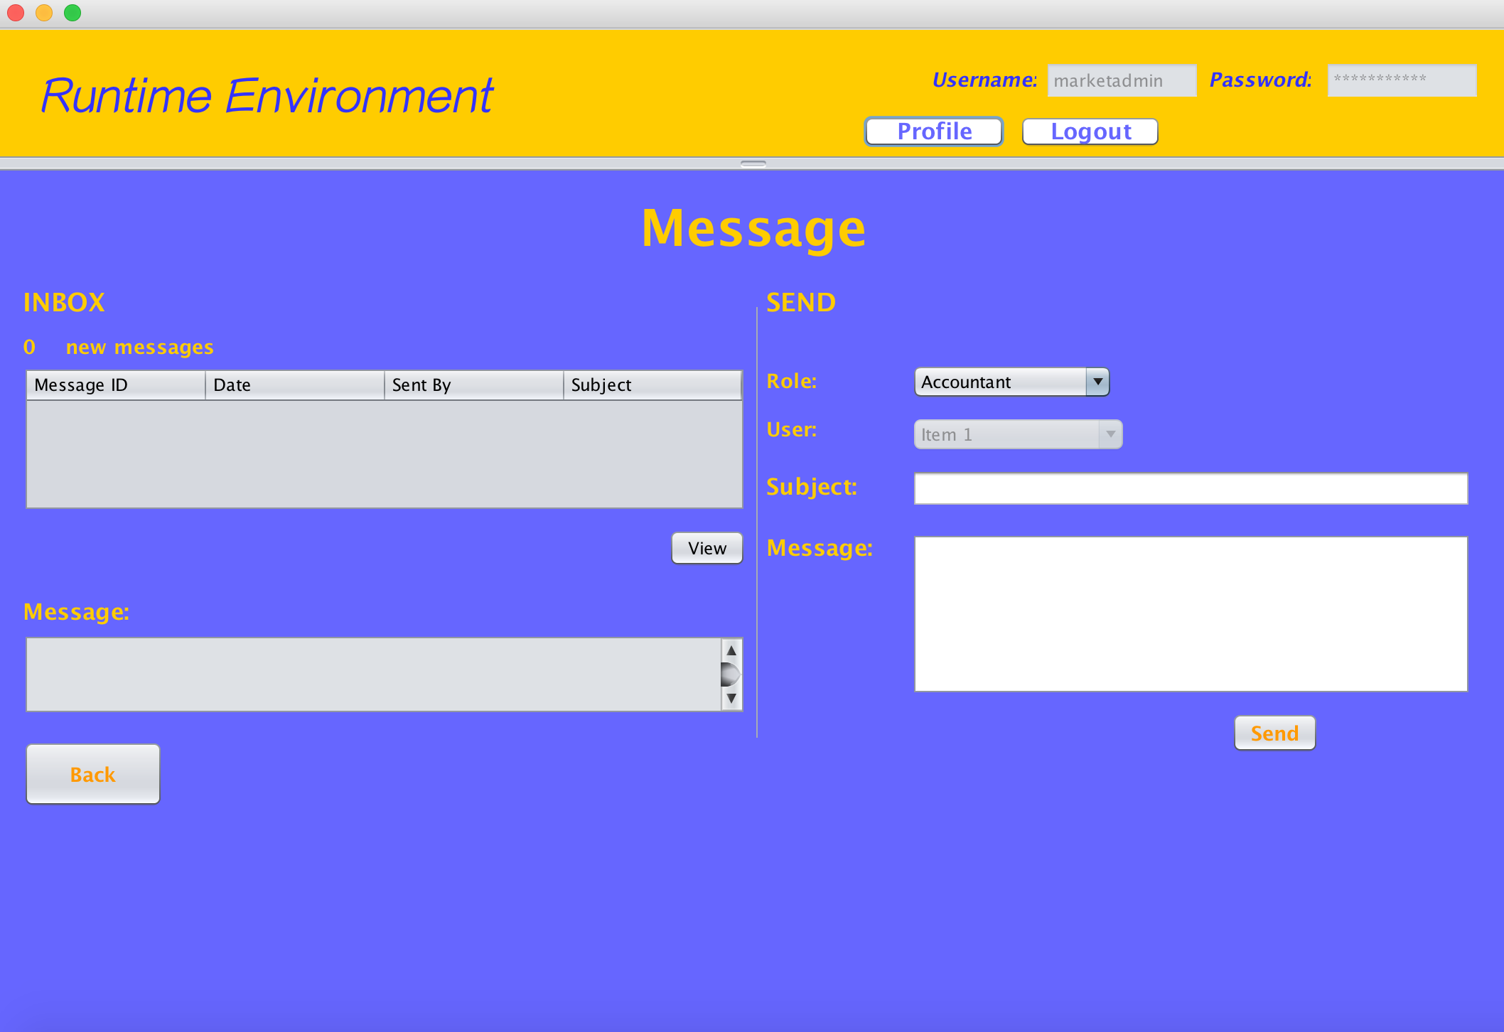
Special Features: Inbox

